Slide 1
Writing Your First Visual Studio Code Extension
@MrThomasRayner
Thomas Rayner
Sr. Security Service Engineer
Microsoft
PowerShell & DevOps Global Summit 2020 DuPSUG

Slide 2

Thomas Rayner
Certified Information Systems Security Professional (CISSP)
Sr Security Service Engineer @ Microsoft
@MrThomasRayner
thomasrayner.ca | PowerShell Discord/Slack aka.ms/psdiscord aka.ms/psslack
aka.ms/MTRPresenations | aka.ms/AzureAutomationPS

Slide 3



If you write code then you’re a dev
@MrThomasRayner

Slide 4
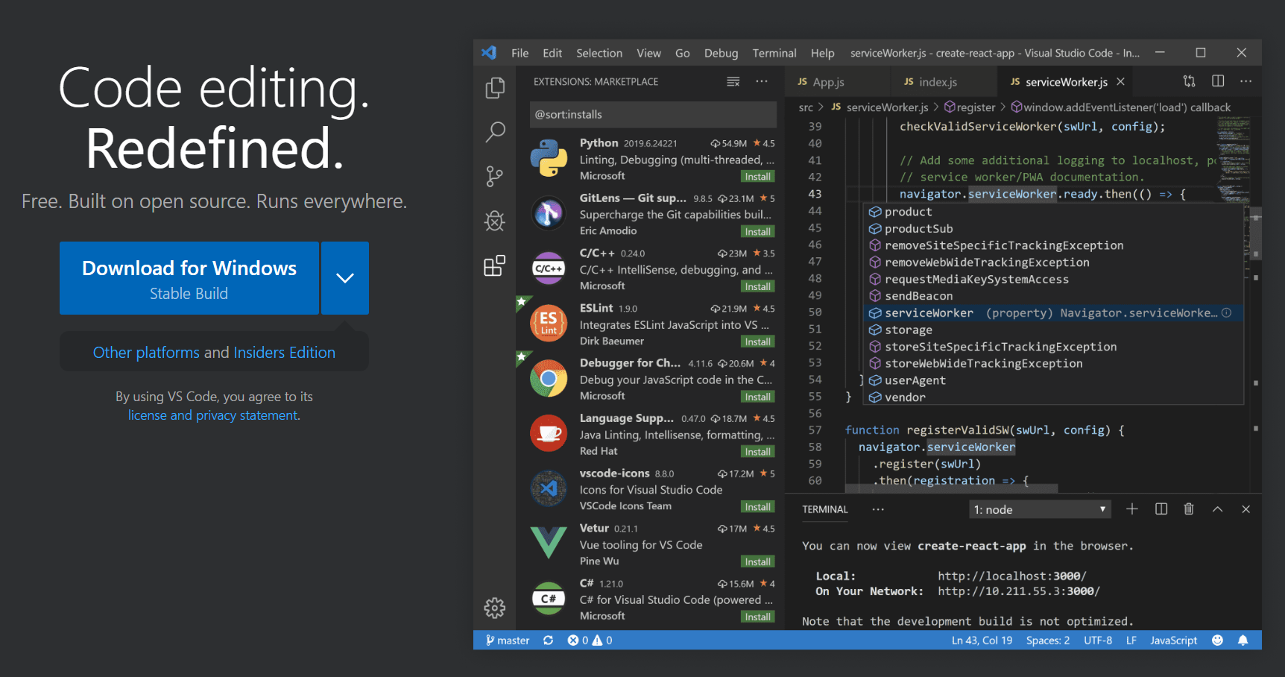
Notes:
Text editor by Microsoft
Open source on github
Cross platform
Debugging, source control, syntax highlighting, snippets, code refactoring
The defacto code editor for PowerShell
Very, VERY extensible

Slide 5
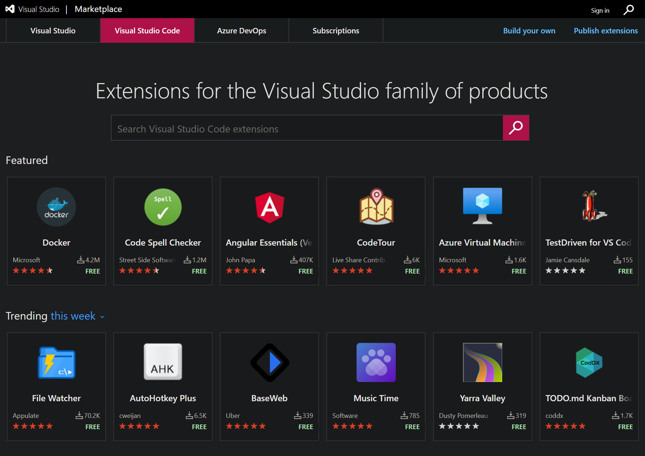
Notes:
A whole world of extensions
Many by Microsoft, other popular projects and products making extensions for VS Code
Anybody can make an extension and make it available for anybody to use

Slide 6
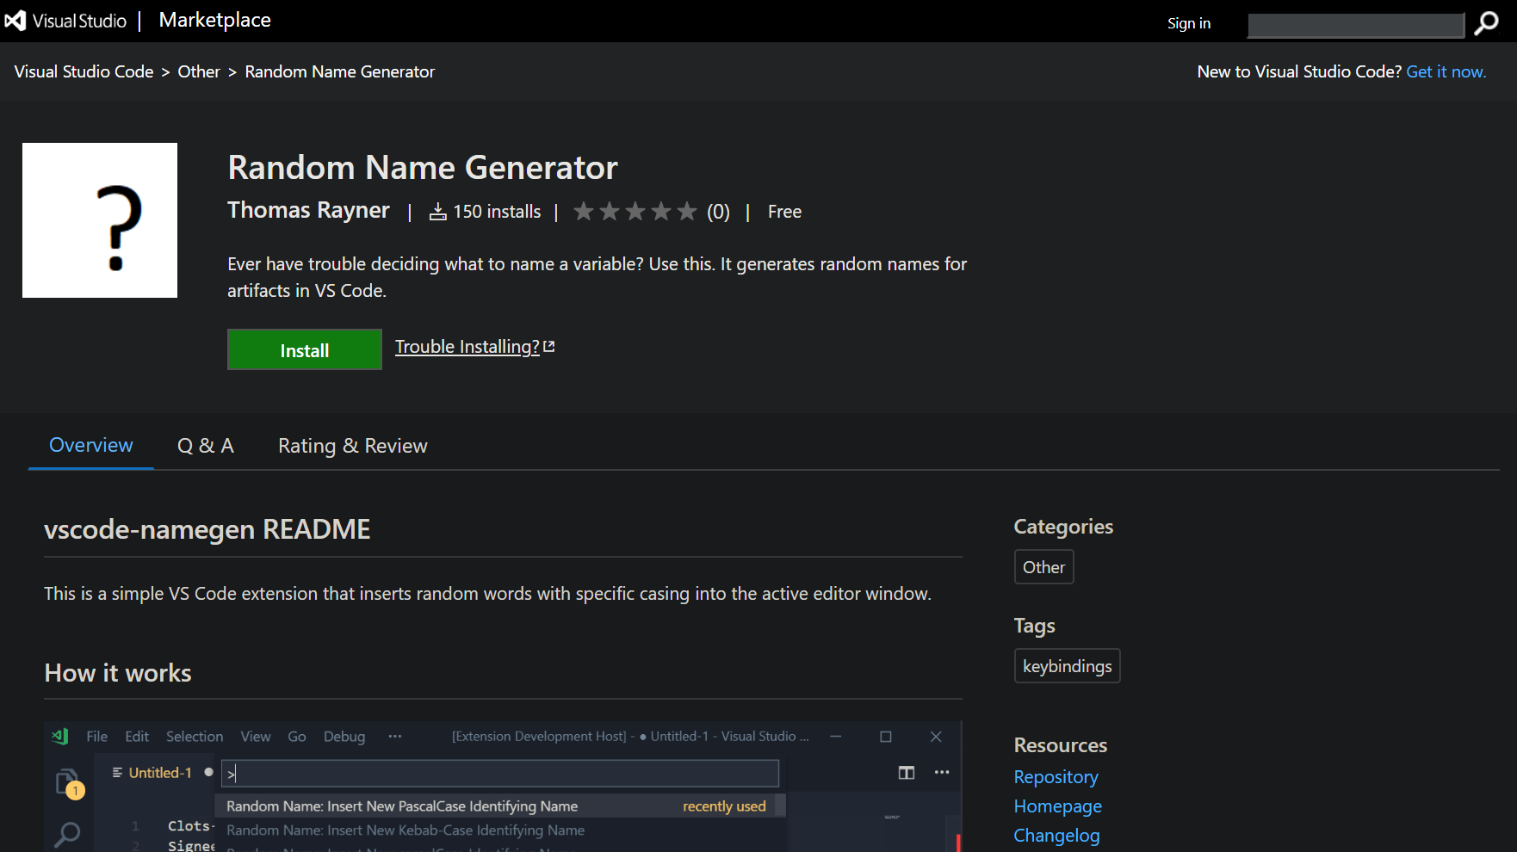

Notes:
- I made this just to learn about the developing VS Code extensions

Slide 7
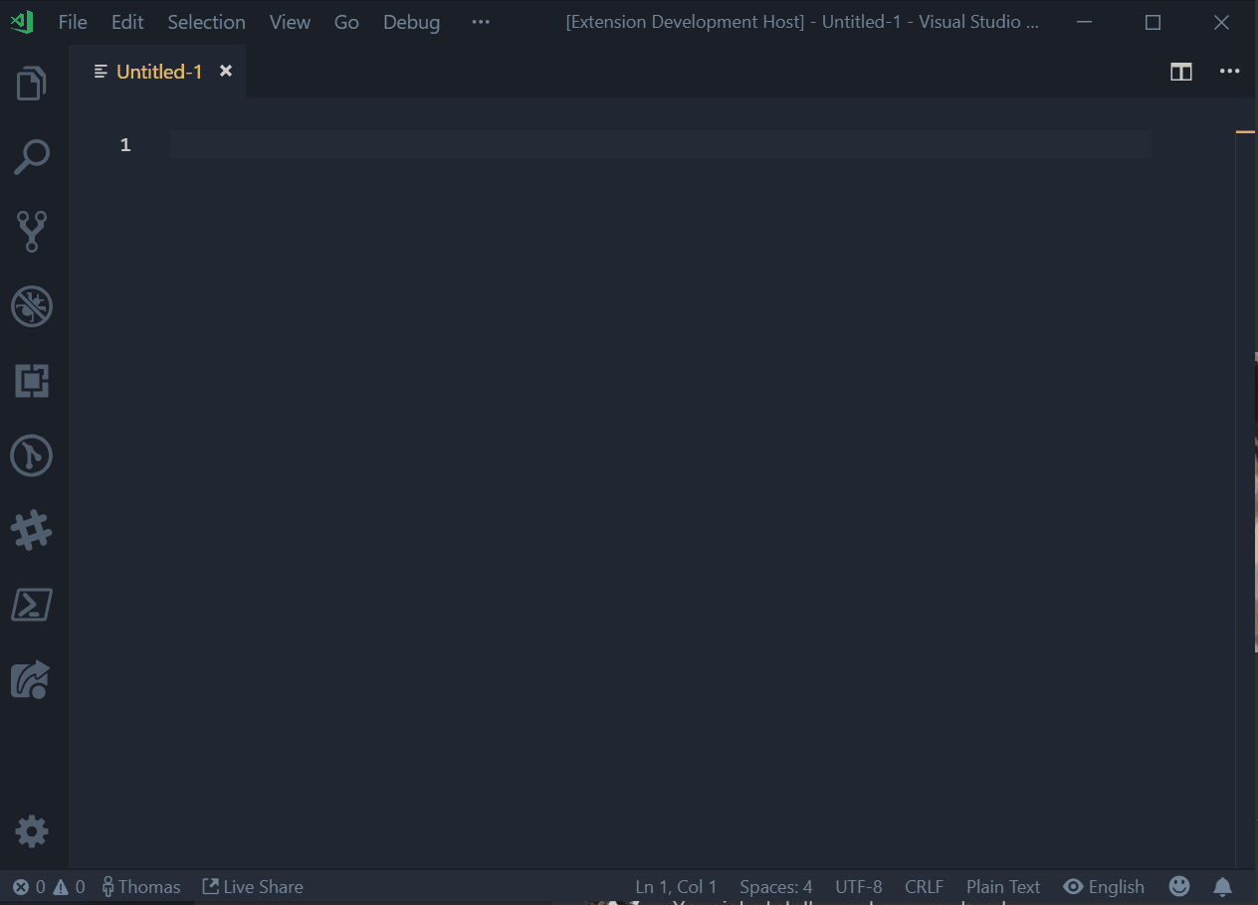
Notes:
Here’s what it does – inserts random words with the casing option you choose
Variety of dictionaries, settings for how many words to use, preferred default case, keyboard shortcut
There’s actually some work put into this

Slide 8
Cute, but is there something productive I can do?
@MrThomasRayner
Theming
Change the look of VS Code with a color or icon theme
Extending the Workbench
Add custom components & views in the UI
Webviews
Create a Webview to display a custom webpage built with HTML/CSS/JS
Language Extensions
Support a new programming language
Debugger Extensions
Support debugging a specific runtime

Slide 9
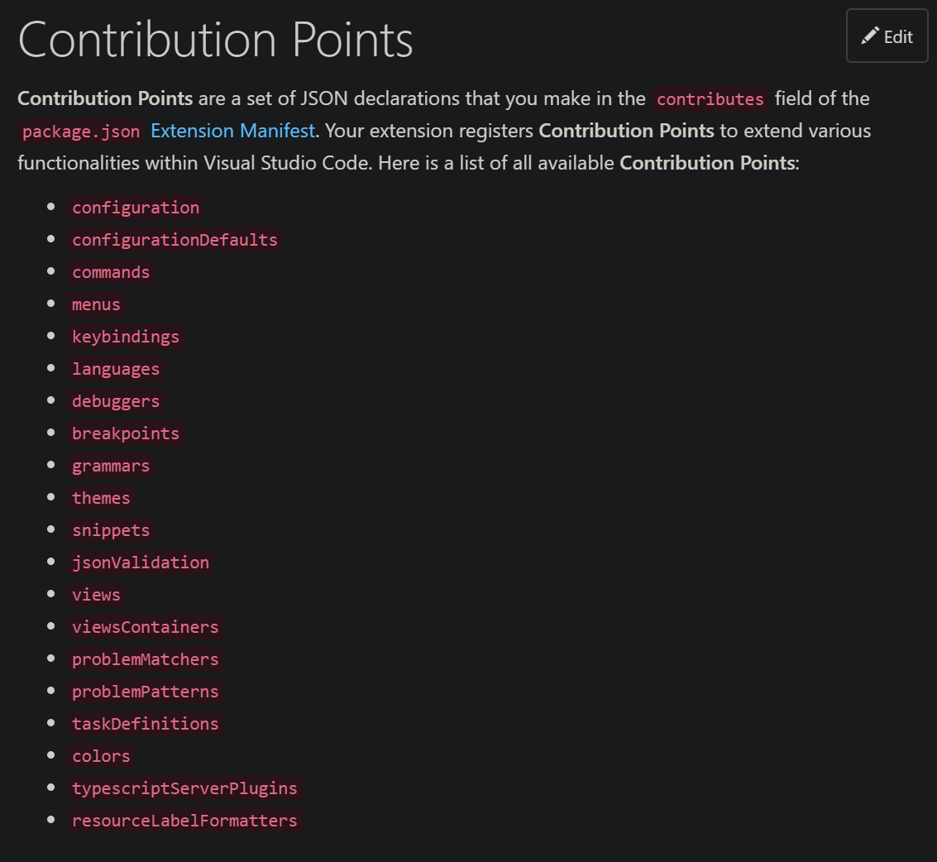
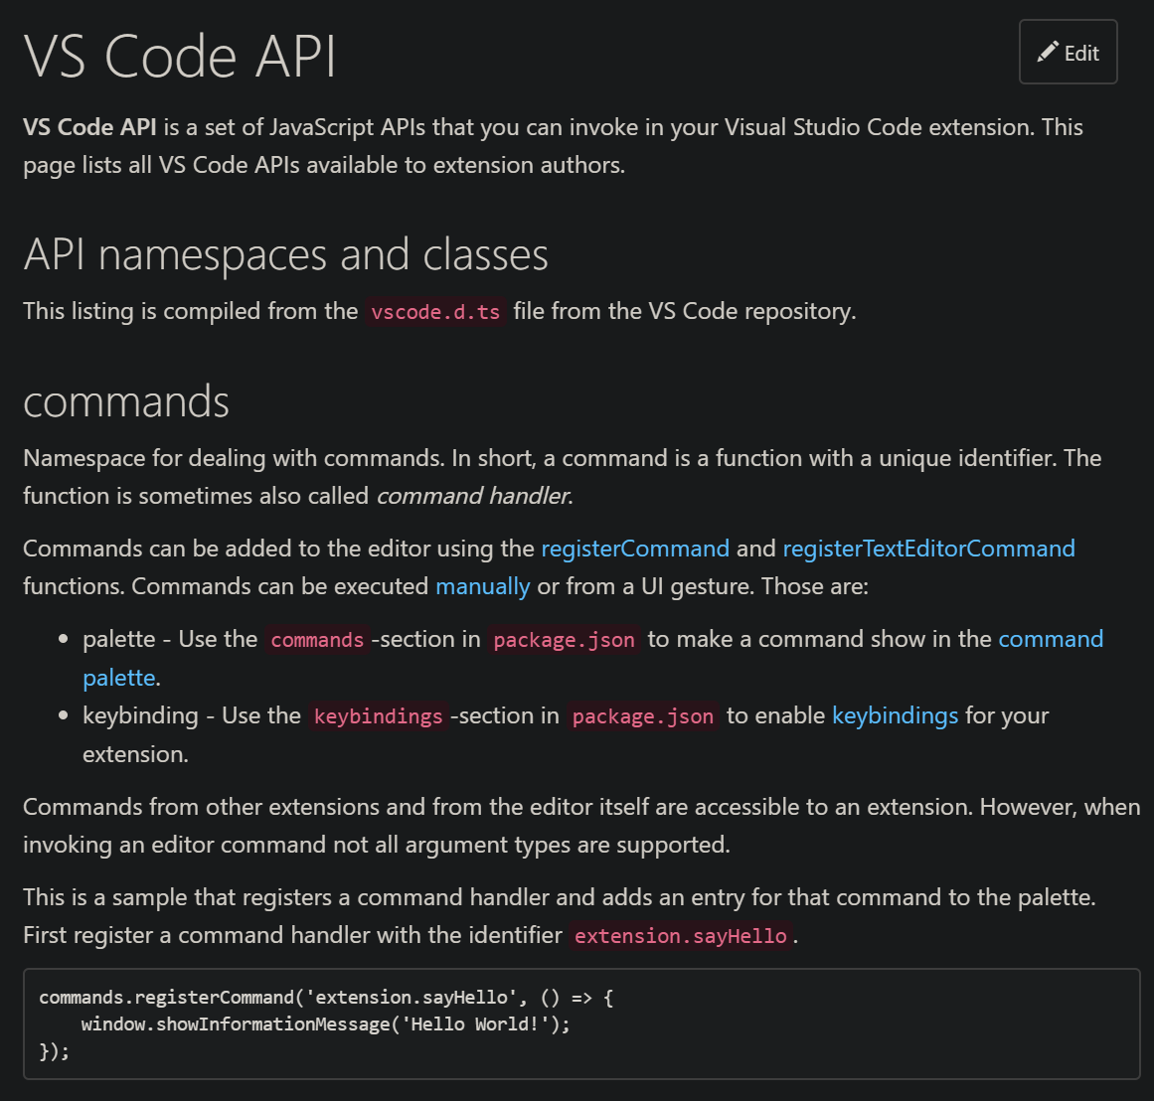
Your new best friends
Contribution Points Reference Guide
https://code.visualstudio.com/api/references/contribution-points
API Reference
https://code.visualstudio.com/api/references/vscode-api
Notes:
Contribution Points are a set of JSON declarations that you make in the contributes field of the package.json Extension Manifest. Your extension registers Contribution Points to extend various functionalities within Visual Studio Code.
Basically, what does your extension actually contribute to VS Code?
Needs to be declared.
VS Code API is a set of JavaScript APIs that you can invoke in your Visual Studio Code extension. This page lists all VS Code APIs available to extension authors.
How to interact with VS Code.

Slide 10
By the way…
There’s a “Writing Your First Extension” guide
https://code.visualstudio.com/api/get-started/your-first-extension

Slide 11
Setting Yourself Up For Success
Install Chocolatey
Set-ExecutionPolicy Unrestricted -Force
Invoke-Expression ((New-Object System.Net.WebClient).DownloadString('https://chocolatey.org/install.ps1’))
Install VS Code and Node.js
choco install vscode nodejs –y
Install Yeoman, the VS Code Yeoman generator, Typescript
npm install -g yo generator-code vsce typescript

Slide 12
Create Your First Extension
Use Yeoman to setup your scaffolding
yo code # follow wizard
Write some code or something
code .\name-of-ext
Read a lot of docs
Contribution Points reference
API reference

Slide 13
What to do when you’re done
Build your extension
npm run compile
Package your extension
vsce package

Slide 14



Let’s Make an Extension
Thank you for subscribing to cat facts!
Notes:
CatFacts extension
Will retrieve and insert a random cat fact to use as filler text
Reach out to a cat facts API, insert the text where the cursor is in the editor
This is going to be an introduction to working with the docs, as well as creating an extension

Slide 15
Thank you!
Thomas Rayner
@MrThomasRayner
thomasrayner.ca | PowerShell Discord/Slack aka.ms/psdiscord aka.ms/psslack
aka.ms/MTRPresenations | aka.ms/AzureAutomationPS

